Slide 1
Semi-Supervised Learning
Lukas Tencer
PhD student @ ETS

Slide 2
Motivation

Slide 3
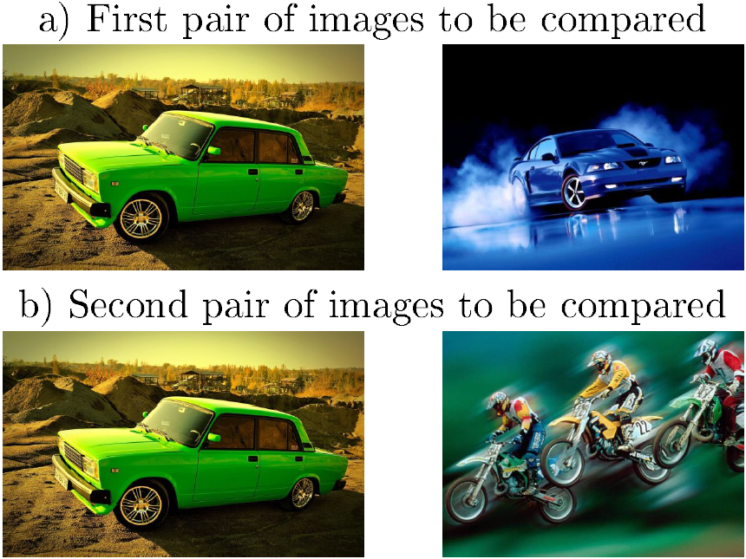
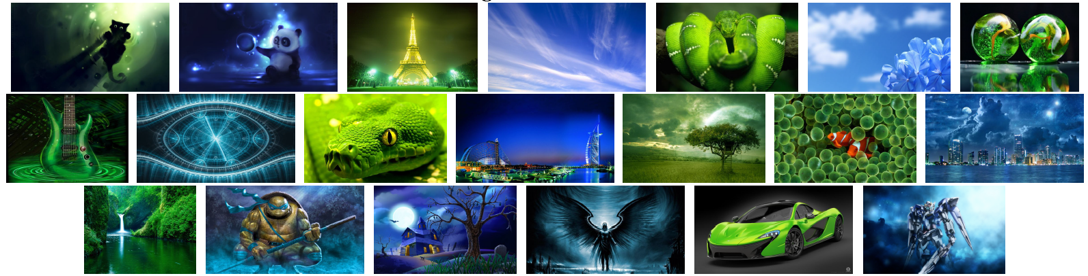
Image Similarity
- Domain of origin

Slide 4
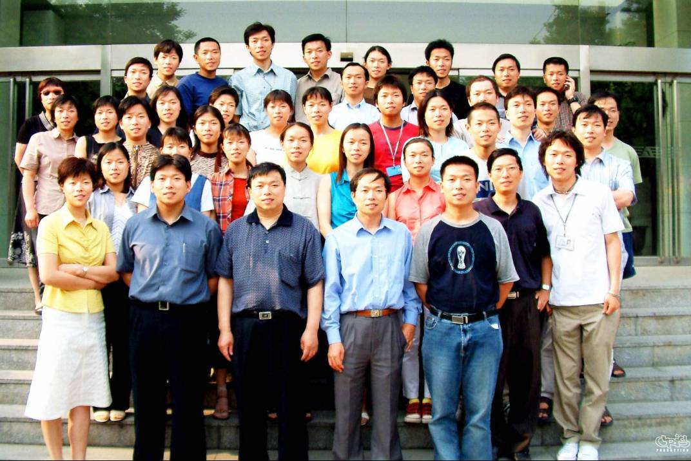
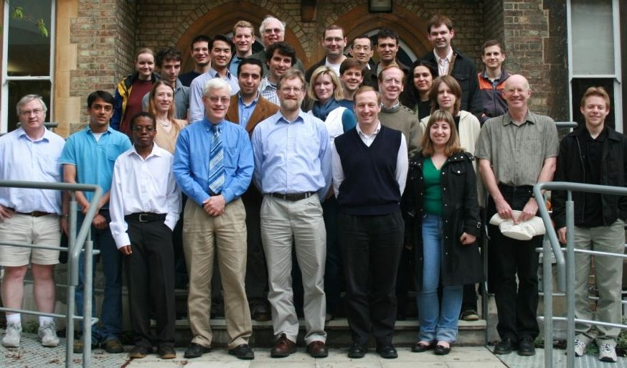
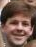
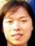
Face Recognition
- Cross-race effect

Slide 5
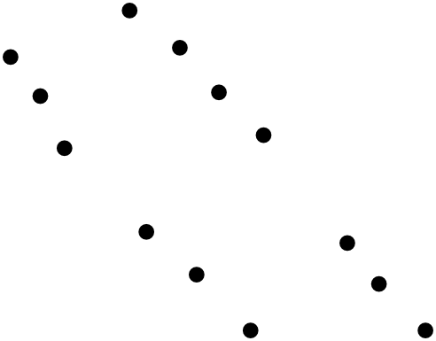

Motivation in Machine Learning

Slide 6
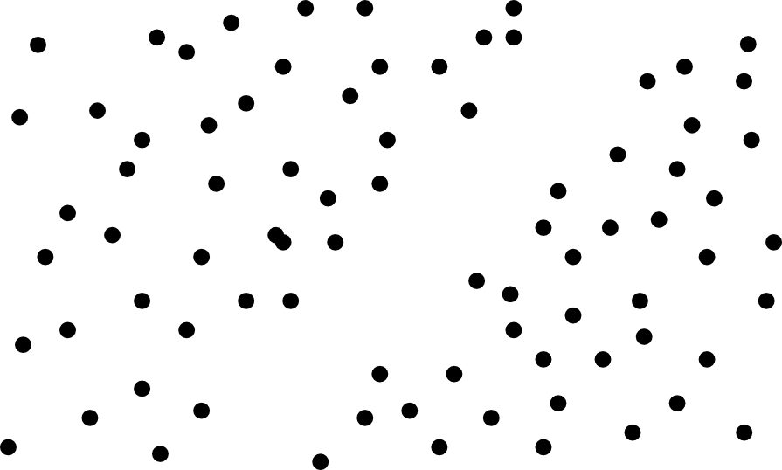


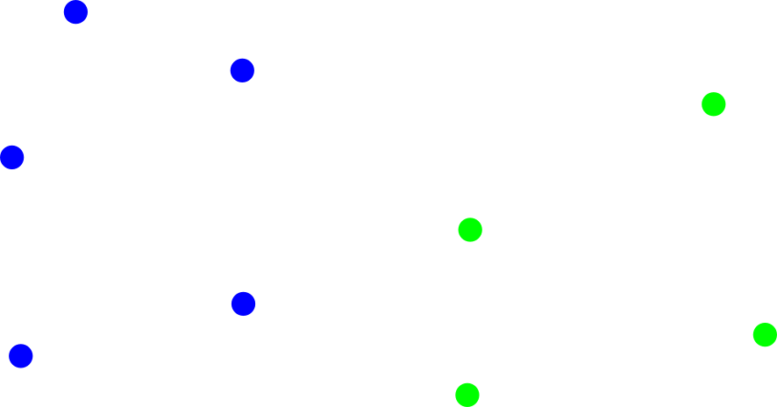
Motivation in Machine Learning

Slide 7
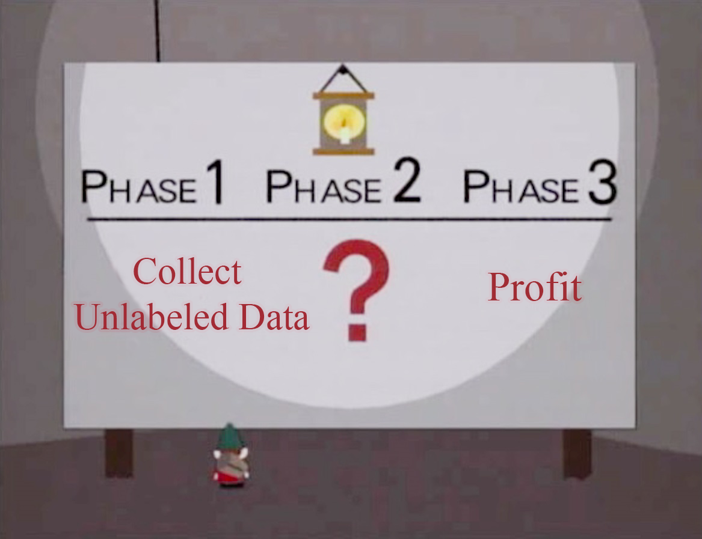
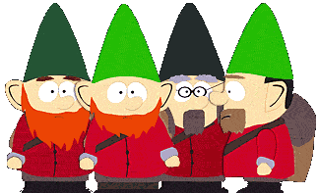
Methodology

Slide 8
When to use Semi-Supervised Learning?
Labelled data is hard to get and expensive
Speech analysis:
Switchboard dataset
400 hours annotation time for 1 hour of speech
Natural Language Processing
Penn Chinese Treebank
2 Years for 4000 sentences
Medical Application
Require experts opinion which might not be unique
Unlabelled data is cheap

Slide 9
Types of Semi-Supervised Leaning
Transductive Learning
Does not generalize to unseen data
Produces labels only for the data at training time
1. Assume labels
2. Train classifier on assumed labels
Inductive Learning
Does generalize to unseen data
Not only produces labels, but also the final classifier
Manifold Assumption

Slide 10
Selected Semi-Supervised Algorithms
Self-Training
Help-Training
Transductive SVM (S3VM)
Multiview Algorithms
Graph-Based Algorithms
Generative Models
…….
…..
…

Slide 11
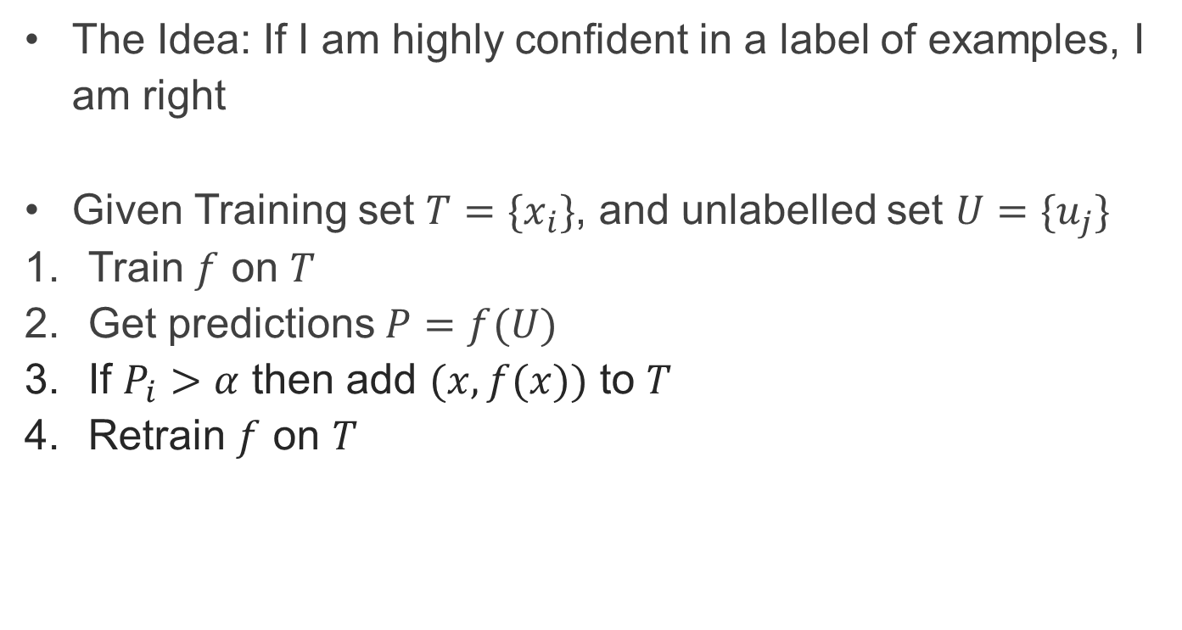
Self-Training
The Idea: If I am highly confident in a label of examples, I am right
Given Training set $T=\{x_{i}\}$, and unlabelled set $U=\{u_{j}\}$
Train $f$ on $T$
Get predictions $P=f(U)$
If $P_{i}>α$ then add $(x,f(x))$ to $T$
Retrain $f$ on $T$

Slide 12
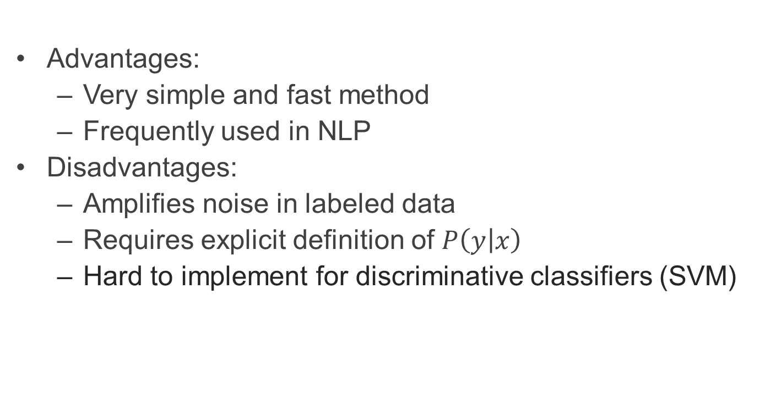
Self-Training
Advantages:
Very simple and fast method
Frequently used in NLP
Disadvantages:
Amplifies noise in labeled data
Requires explicit definition of $P\left(y | x\right)$
Hard to implement for discriminative classifiers (SVM)

Slide 13
Self-Training
Naïve Bayes Classifier on Bag-of-Visual-Word for 2 Classes
Classify Unlabelled Data base on Learned Classifier

Slide 14
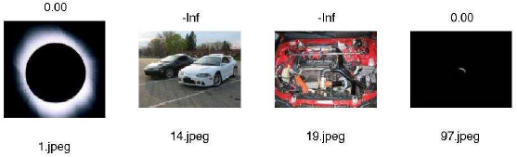
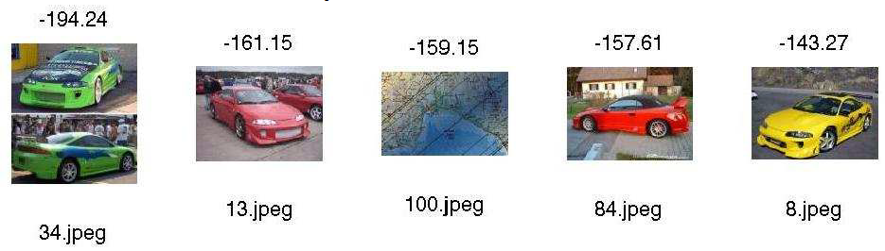
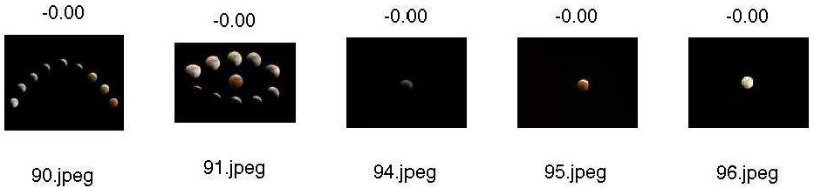
Self-Training
Add the most confident images to the training set
Retrain and repeat

Slide 15
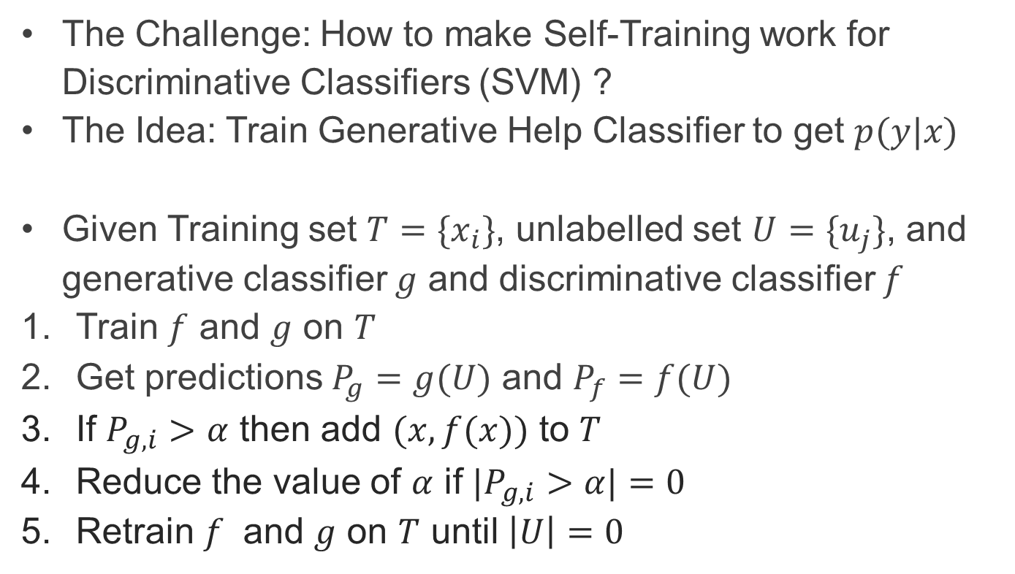
Help-Training
The Challenge: How to make Self-Training work for Discriminative Classifiers (SVM) ?
The Idea: Train Generative Help Classifier to get $p(y|x)$
Given Training set $T=\{x_{i}\}$, unlabelled set $U=\{u_{j}\}$, and generative classifier $g$ and discriminative classifier $f$
Train $f$ and $g$ on $T$
Get predictions $P_{g}=g(U)$ and $P_{f}=f(U)$
If $P_{g,i}>α$ then add $(x,f(x))$ to $T$
Reduce the value of $α$ if ${|P}_{g,i}>α|=0$
Retrain $f$ and $g$ on $T$ until $\left|U\right|=0$

Slide 16
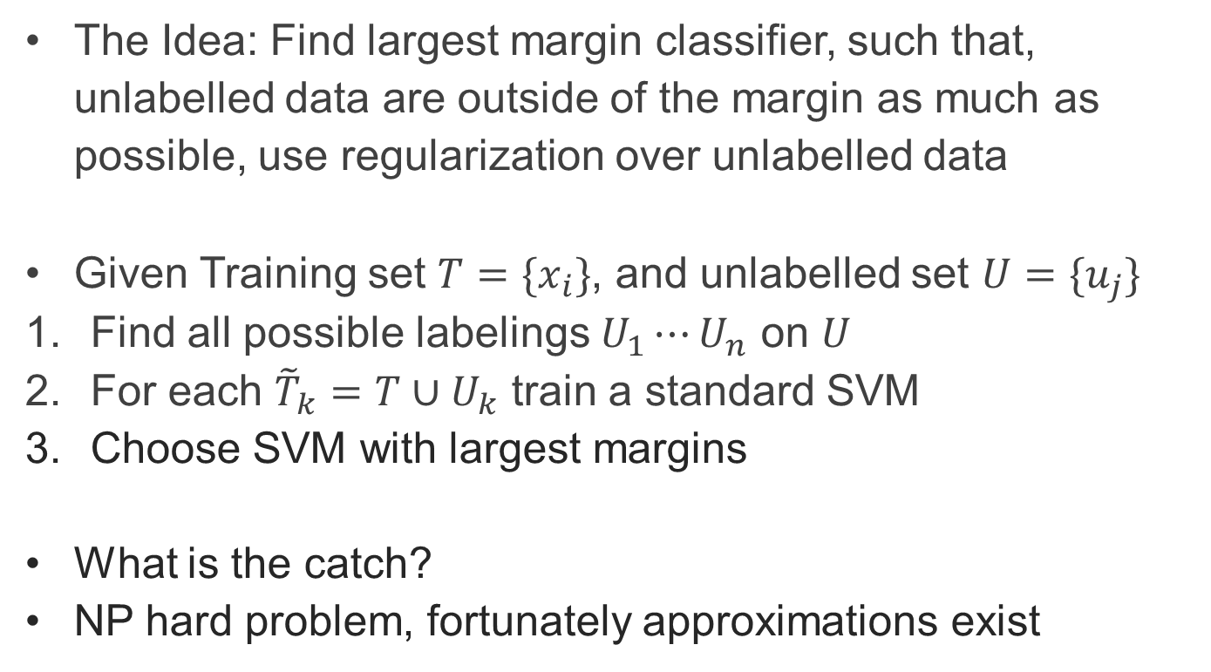
Transductive SVM (S3VM)
The Idea: Find largest margin classifier, such that, unlabelled data are outside of the margin as much as possible, use regularization over unlabelled data
Given Training set $T=\{x_{i}\}$, and unlabelled set $U=\{u_{j}\}$
Find all possible labelings $U_{1}⋯U_{n}$ on $U$
For each ${\tilde{T}}_{k}=T∪U_{k}$ train a standard SVM
Choose SVM with largest margins
What is the catch?
NP hard problem, fortunately approximations exist

Slide 17
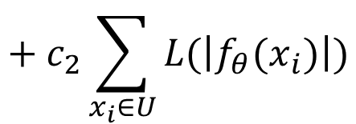
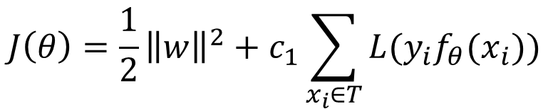
Transductive SVM (S3VM)
Solving non-convex optimization problem:
Methods:
Local Combinatorial Search
Standard unconstrained optimization solvers (CG, BFGS…)
Continuation Methods
Concave-Convex procedure (CCCP)
Branch and Bound
$$J\left(θ\right)=\frac{1}{2}{\left\|w\right\|}^{2}+c_{1}\sum_{x_{i}∈T}{L(y_{i}f_{θ}(x_{i}))}$$
$$+ c_{2}\sum_{x_{i}∈U}{L(\left|f_{θ}(x_{i})\right|)}$$

Slide 18
Transductive SVM (S3VM)
Advantages:
Can be used with any SVM
Clear optimization criterion, mathematically well formulated
Disadvantages:
Hard to optimize
Prone to local minima – non convex
Only small gain given modest assumptions

Slide 19
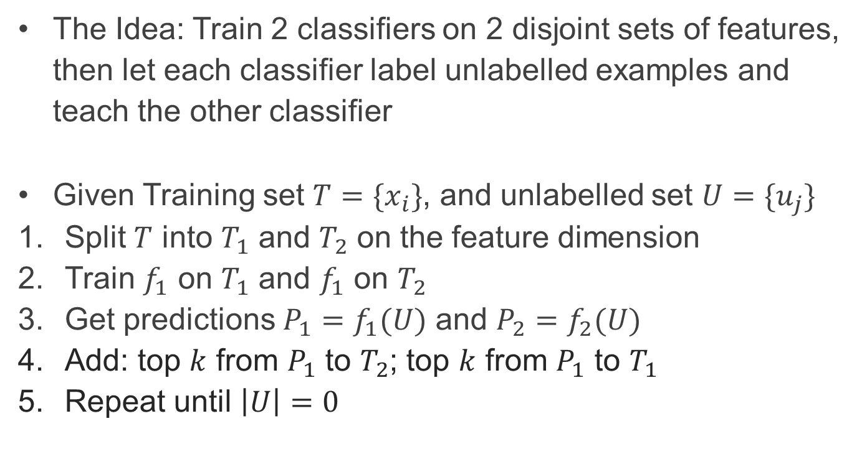
Multiview Algorithms
The Idea: Train 2 classifiers on 2 disjoint sets of features, then let each classifier label unlabelled examples and teach the other classifier
Given Training set $T=\{x_{i}\}$, and unlabelled set $U=\{u_{j}\}$
Split $T$ into $T_{1}$ and $T_{2}$ on the feature dimension
Train $f_{1}$ on $T_{1}$ and $f_{1}$ on $T_{2}$
Get predictions $P_{1}=f_{1}(U)$ and $P_{2}=f_{2}(U)$
Add: top $k$ from $P_{1}$ to $T_{2}$; top $k$ from $P_{1}$ to $T_{1}$
Repeat until $\left|U\right|=0$

Slide 20
Multiview Algorithms
Application: Web-page Topic Classification
1. Classifier for Images; 2. Classifier for Text

Slide 21
Multiview Algorithms
Advantages:
Simple Method applicable to any classifier
Can correct mistakes in classification between the 2 classifiers
Disadvantages:
Assumes conditional independence between features
Natural split may not exist
Artificial split may be complicated if only few eatures

Slide 22
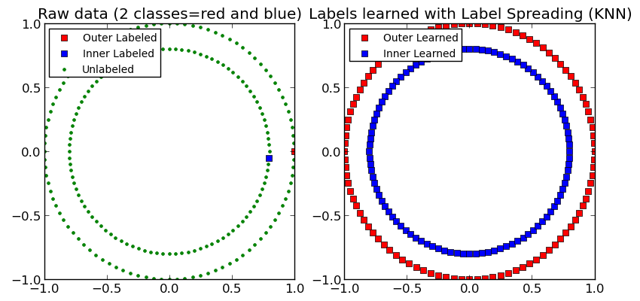
Graph-Based Algorithms
The Idea: Create a connected graph from labelled and unlabelled examples, propagate labels over the graph

Slide 23
Graph-Based Algorithms
Advantages:
Great performance if graph fits the tasks
Can be used in combination with any model
Explicit mathematical formulation
Disadvantages:
Problem if graph does not fit the task
Hard to construct graph in sparse spaces

Slide 24
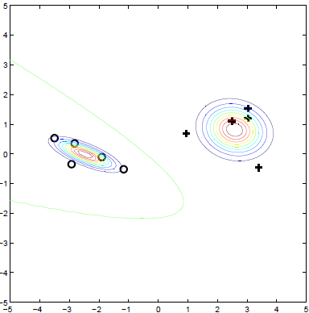
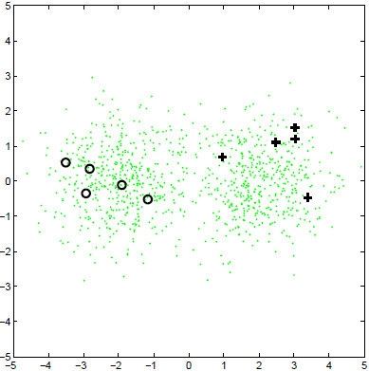
Generative Models
The Idea: Assume distribution using labelled data, update using unlabelled data
Simple models is:
GMM + EM

Slide 25
Generative Models
Advantages:
Nice probabilistic framework
Instead of EM you can go full Bayesian and include prior with MAP
Disadvantages:
EM find only local minima
Makes strong assumptions about class distributions

Slide 26
What could go wrong?
Semi-Supervised Learning make a lot of assumptions
Smoothness
Clusters
Manifolds
Some techniques (Co-Training) require very specific setup
Frequently problem with noisy labels
There is no free lunch

Slide 27
There is much more out there
Structural Learning
Co-EM
Tri-Training
Co-Boosting
Unsupervised pretraining – deep learning
Transductive Inference
Universum Learning
Active Learning + Semi-Supervised Learning
…….
…..
…
My work

Slide 28
Demo

Slide 29
Conclusion
Play with Semi-Supervised Learning
Basic methods are vary simple to implement and can give you up to 5 to 10% accuracy
You can cheat at competitions by using unlabelled data, often no assumption is made about external data
Be careful when running Semi-Supervised Learning in production environment, keep an eye on your algorithm
If running in production, be aware that data patterns change and old assumptions about labels may screw up you new unlabelled data

Slide 30
Some more resources
Videos to watch:
Semisupervised Learning Approaches – Tom Mitchell CMU : http://videolectures.net/mlas06_mitchell_sla/
MLSS 2012 Graph based semi-supervised learning - Zoubin Ghahramani Cambridge : https://www.youtube.com/watch?v=HZQOvm0fkLA
Books to read:
Semi-Supervised Learning – Chapelle, Schölkopf, Zien
Introduction to Semi-Supervised Learning - Zhu, Oldberg, Brachman, Dietterich

Slide 31

THANKS FOR YOUR TIME
Lukas Tencer
lukas.tencer@gmail.com
http://lukastencer.github.io/
https://github.com/lukastencer
https://twitter.com/lukastencer
→



Graduating August 2015, looking for ML and DS opportunities

